Slide 1
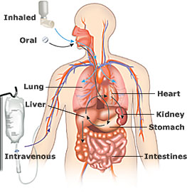
PHARMACOKINETICS

Slide 2
BIOTRANSFORMATION
Drug metabolism/drug inactivation/drug detoxification
The chemical alteration of drug molecules by the body cells of patients to a metabolite that’s in an inactivated, activated, or toxic form.
The altered drug is usually more hydrophilic/ionized than original form, therefore more readily excreted
The altered drug may have less affinity for plasma proteins, therefore they are more widely distributed

Slide 3
4 Pathways of Biotansformation
Oxidation reactions (loss of electrons)
Reduction reactions (gain of electrons)
Hydrolysis (addition of water)
Conjugation (addition of glucuronic acid making the drug more water soluble)

Slide 4
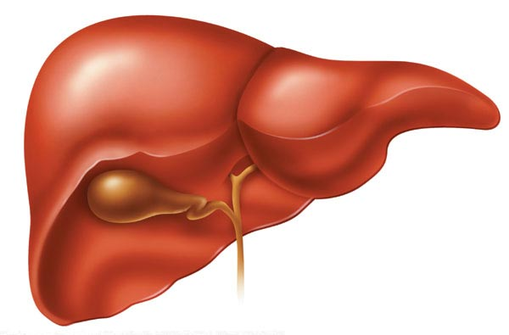
SITES OF BIOTRANSFORMATION
MAINLY: LIVER
  The enzyme Chytochrome P450 is found within the hepatocytes. It is a group of enzymes whose role is to detoxify drugs and alter their structure. Cytochrome P450 can be inhibited or induced
  Other sites of biotransformation: kidneys, small intestines, brain, lungs, skin, neurologic tissue

Slide 5
Ways that drugs interact with one another:
1) Altered absorption- one drug alters the absorption of other drugs. Ex: antacids alter the stomach’s pH, affecting other drug’s ability to be absorbed in the GI tract.
2) Competition for plasma proteins- One drug may alter the ability for another drug to bind to proteins, making it reach toxic levels in the body because it is unbound

Slide 6
3) Altered excretion- drugs can act on the kidney and effect the excretion of other drugs
4) Altered metabolism-
  2 drugs that are given at the same time may require the same enzymes for biotransformation, thus slowing down the metabolism of one or both drugs.
  One drug may induce or increase the rate and effect of biotransformation for both drugs
  These scenarios can increase or decrease the efficacy of the drugs at their prescribed dose

Slide 7
Other factors affecting biotransformation:
1) Storage in fat and other tissues decrease the rate of metabolism
2) Liver disease effects the cytochrome p450 production
3) Young animals have decreased metabolic pathways, a blood-brain barrier that is not yet well established, and a higher percent of body water that affects volume of distribution

Slide 8
Other factors affecting biotransformation:
4) Malnourished animals have decreased plasma protein
5) Different species vary in the ability to biotransform
6) Increased body temperature increases rate of drug metabolism
7) The same drug given in different routes may have different effects on the body

Slide 9
ELIMINATION and EXCRETION
Elimination- removal of drug from the body
  Also called excretion
Routes of elimination: *kidneys, *liver, intestines, lungs, saliva, sweat

Slide 10
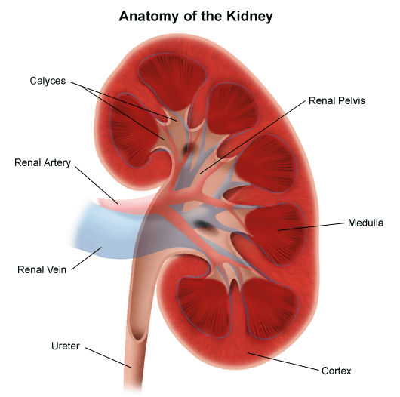
Renal Elimination
Glomerular Filtration – Water and drug molecules are pushed through the capillaries of the glomerulus. Small, nonionic, non-protein bound molecules are pushed through. When blood pressure is high, more molecules are filtered through
Tubular Secretion – Moving drugs through the convoluted tubule from blood to urine. More rapid than glomerular fitration. This process requires energy.

Slide 11
Renal Elimination
Tubular Reabsorption – Takes place in the Loop of Henle and depends on solubility and size. Highly lipid soluble/nonionized are reabsorbed well.
Urine pH – changes the form of drug to one that is more readily excreted or reabsorbed.
  Weak acids are better excreted in basic urine
  Weak bases are better excreted in acidic urine

Slide 12
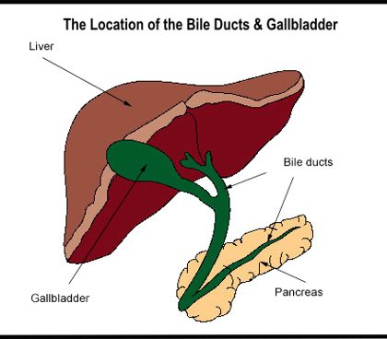
Hepatic Elimination
Drugs passively diffuse from the blood into the hepatocyte where they are then secreted into the bile
Bile is then secreted into the duodenum.
  LIPOPHILIC drugs entering
  the duodenum reenter the
  bloodstream and goes back
  into the liver
  HYDROPHILIC drugs entering
  the duodenum become part of the
  feces and are eliminated from the body

Slide 13
Intestinal Elimination
Occurs when drugs are given orally and are not absorbed, allowing them to pass through the feces
Occurs when drugs are excreted into the bile, allowing them to pass through the feces
Occurs when drugs are actively secreted across mucous membranes into the gut

Slide 14
PULMONARY ELIMINATION
Movement of drug molecules out of blood and into the alveoli of the lungs and eliminated into the expired air

Slide 15
MILK ELIMINATION
Drugs can pass from the blood to the milk via the mammary glands. Important in the selection of drugs for a pregnant or nursing animal.
This is also important to humans in avoiding drug residues in milk, eggs, and meat. Residues can lead to allergic reactions, antibiotic resistance, and disease development.

Slide 16

WITHDRAWAL TIMES
Period of time after drug administration during which the animal cannot be sent to market for slaughter and the eggs/milk must be discarded

Slide 17
Drugs that are approved and produce residues have a withdrawal time established
Calculated using the half-life of the drug (T_{1/2} = the time required for the amount of drug in the body to be reduced by half.)
  Can be used to know how quickly a drug is eliminated by the body and the drug’s steady state
  STEADY STATE – when drug accumulation and elimination are balanced

Slide 18
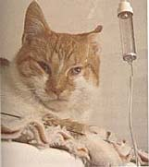

THE PATIENT’S EFFECT ON DRUG EXCRETION
HYDRATION STATUS- Dehydrated animals have less blood volume and subsequent decreased blood pressure in the glomerulus, affecting the amount of drugs that are filtered through
AGE and DISEASE – alter the amount of blood protein and the and the ability of the protein to bind to drugs. Animals with less protein have more free drug. This may allow the drug to be excreted before it has time to take effect.

Slide 19
How Do Drugs Work?
Drugs work in a variety of ways:
  Drugs alter existing cellular functions
  Drugs alter the chemical composition of body fluids
  Drugs can form a chemical bond with specific cell components on target cells within the animal’s body

Slide 20
Receptors
Receptors are three-dimensional proteins or glycoproteins
  Located on the surface, in the cytoplasm, or within the nucleus of cells
Affinity is the strength of binding between a drug and its receptor
  High-affinity drugs bind more tightly to a receptor than do low-affinity drugs

Slide 21

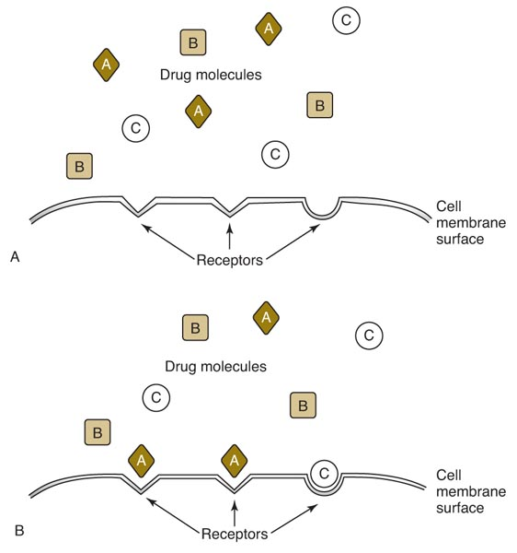
Receptors
Copyright © 2011 Delmar, Cengage Learning

Slide 22
Agonist vs. Antagonist
Agonist: drug that binds to a cell receptor and causes action
Antagonist: drug that inhibits or blocks the response of a cell when the drug is bound to the receptors

Slide 23
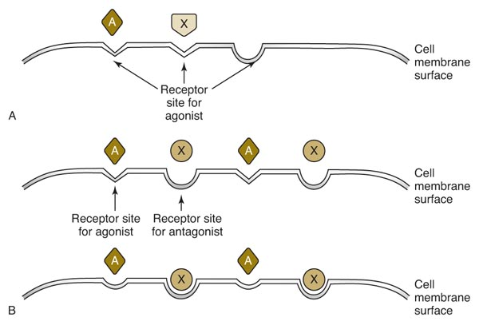
Agonist vs. Antagonist
Copyright © 2011 Delmar, Cengage Learning

Slide 24
Measuring Drug Action
Graphic depiction of the plasma concentration of the drug vs. time
  X axis represents time
  Y axis represents drug concentration in plasma
Onset of action occurs when the drug enters the plasma
The peak plasma level of the drug is when the elimination rate of the drug is equivalent to its rate of absorption

Slide 25
Measuring Drug Action
The time elapsed from the time of administration to the time that the peak plasma level is reached is known as the time to peak
  Important in making clinical judgments about the use of a drug
From the peak plasma level the concentration declines since the amount of drug being eliminated exceeds the amount being absorbed

Slide 26
